Slide 1

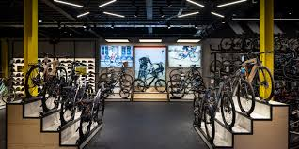
Bike Store Data Analysis Project
SQL Analysis of the BikeStores Database
Team Members:
Abhijith S D
Arvind C R
Ayyasamy S
Gurumurthy Kalyanpur Viswanathaiah
Manjunath

Slide 2
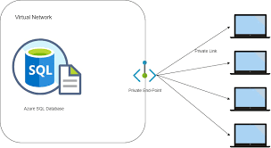


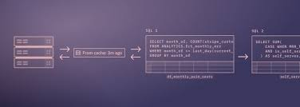

Project Overview and Setup
Objective:
- To provide actionable insights derived from the bike store dataset.
- To assist in making informed business decisions based on data analysis.
Dataset Overview:
- Scope - Data Import and Schema Overview, Data Analysis Using SQL (Descriptive Statistics, Data Cleaning, Aggregation and Grouping, Joins and Relationships, Use of Sub-queries, CTEs and Advanced Functions,), Insights and Conclusion.
- Dataset Includes - Brands, Categories, Customers, Order Items, Orders, Staff, Stocks and Stores details.

Slide 3
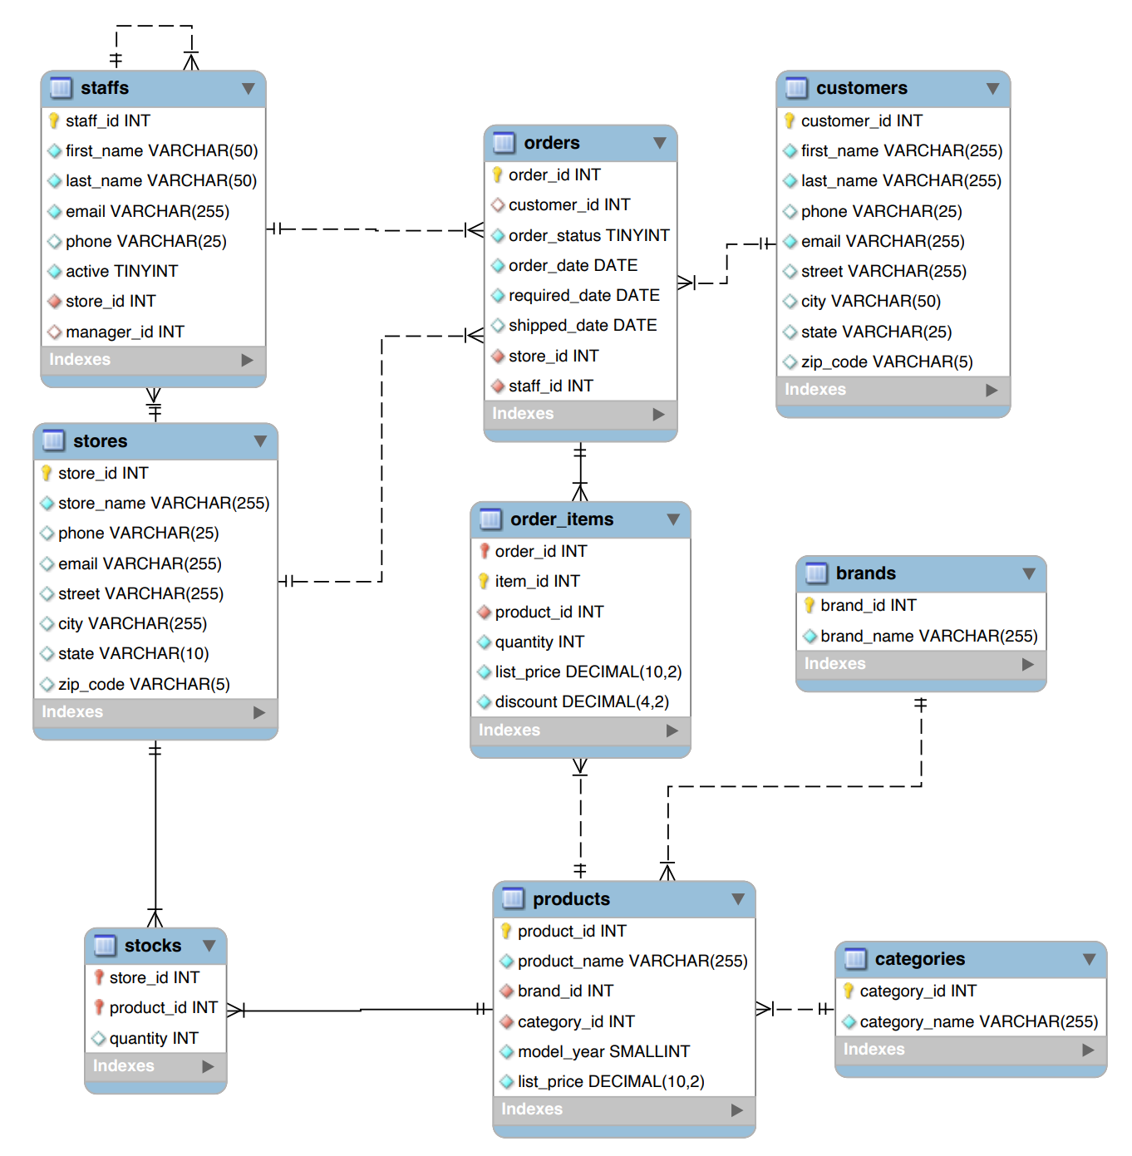
Entity Relationship Diagram
Entity Relationship:
1. Products belong to Brands and Categories.
2. Customers place Orders, which contain Order Items that reference Products. Orders are managed by Staff and linked to Stores.
3. Staff work at Stores and may manage other Staff.
4. Stocks track Products available at Stores.

Slide 4
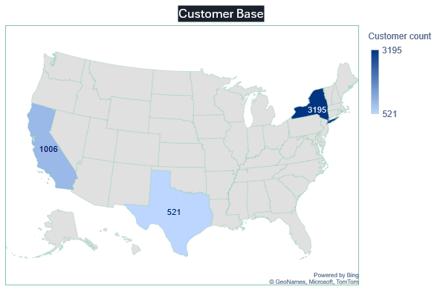
Customer Base
Regions: Customers are mainly distributed across New York, California and Texas.
Observation:
We have largest customer base in New York.

Slide 5
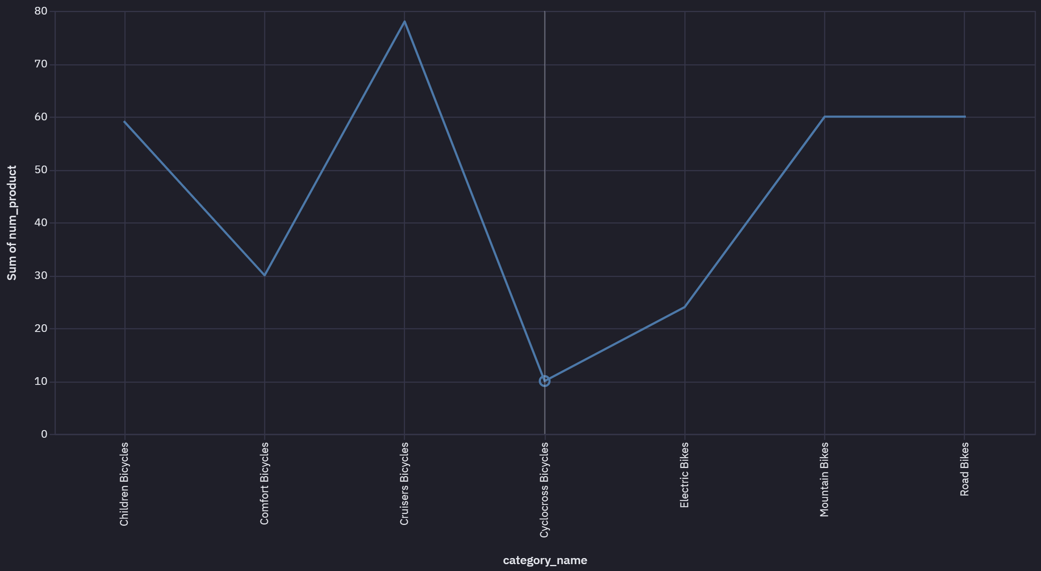
Products diversity across categories
Observation :
Cyclocross Bicycles and Electric Bikes seem to have lesser products diversity
Next Step:
Review the sales pattern if Cruisers Bicycles and Mountain Bikes really have demand across products range.

Slide 6
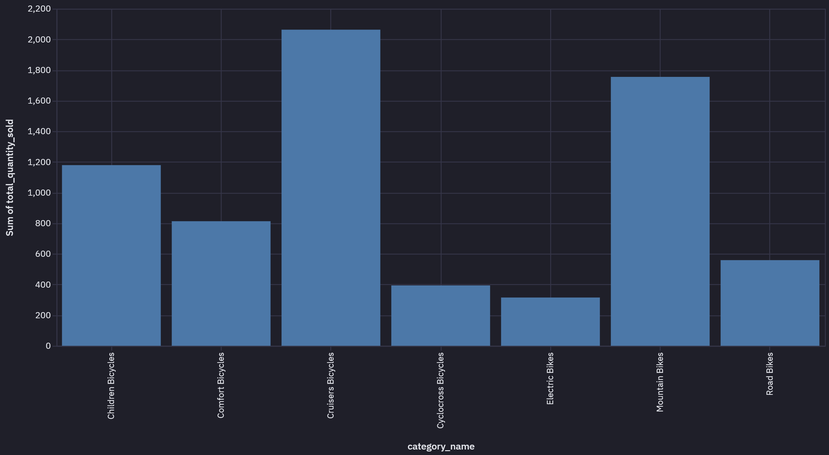
Sales Summary by Category
Context :
Sales Summary by Quantity across categories
Insight :
Observed higher sales in the categories of Cruiser bikes and Mountain bikes, possibly Cruiser bikes are used for leisure riding and are the most popular. Mountain bikes used for adventure cycling are also quite popular.

Slide 7
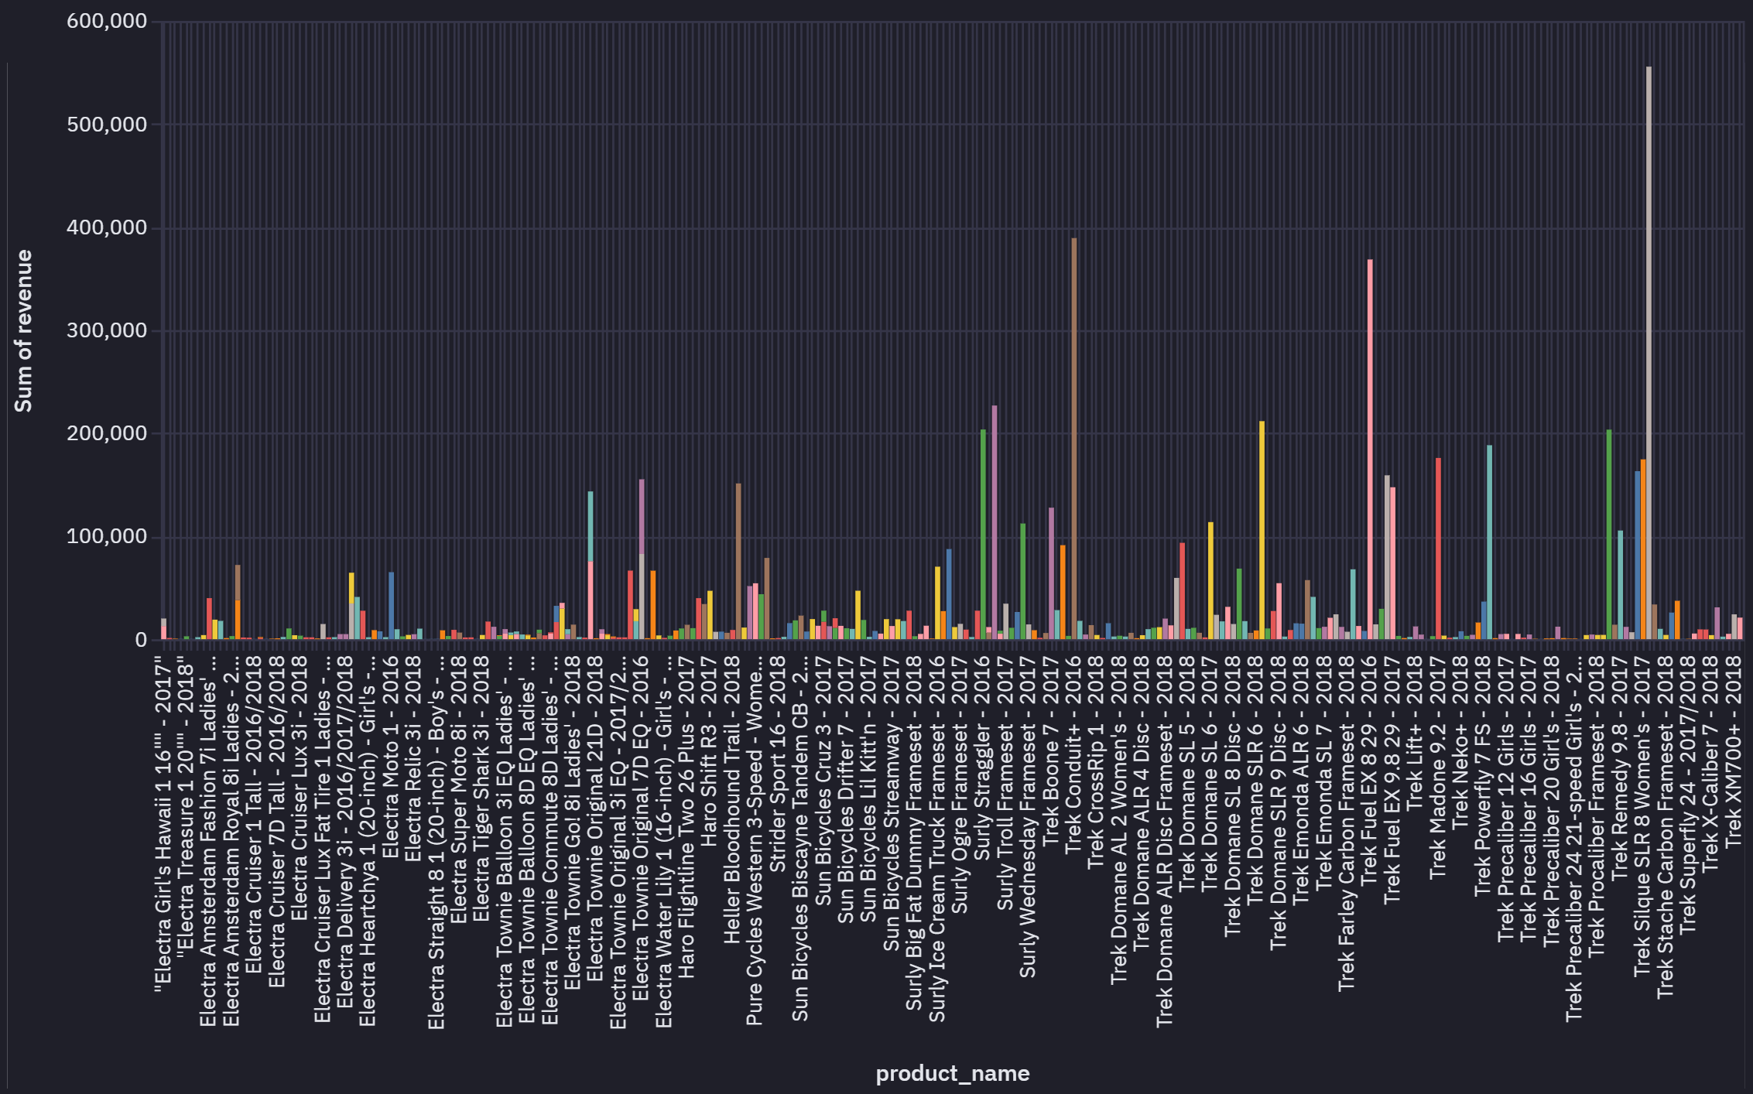
Sales Performance by Product
Context :
Total sales per product: Query to calculate the total sales amount for each product (considering quantity, list price, and discount).
Insight :
-- Trek Slash 8 27.5 = 2016 has been the highest revenue generating model amongst others.
-- Revenue (In Dollars) total_sales_volume as well as revenue_per_item

Slide 8
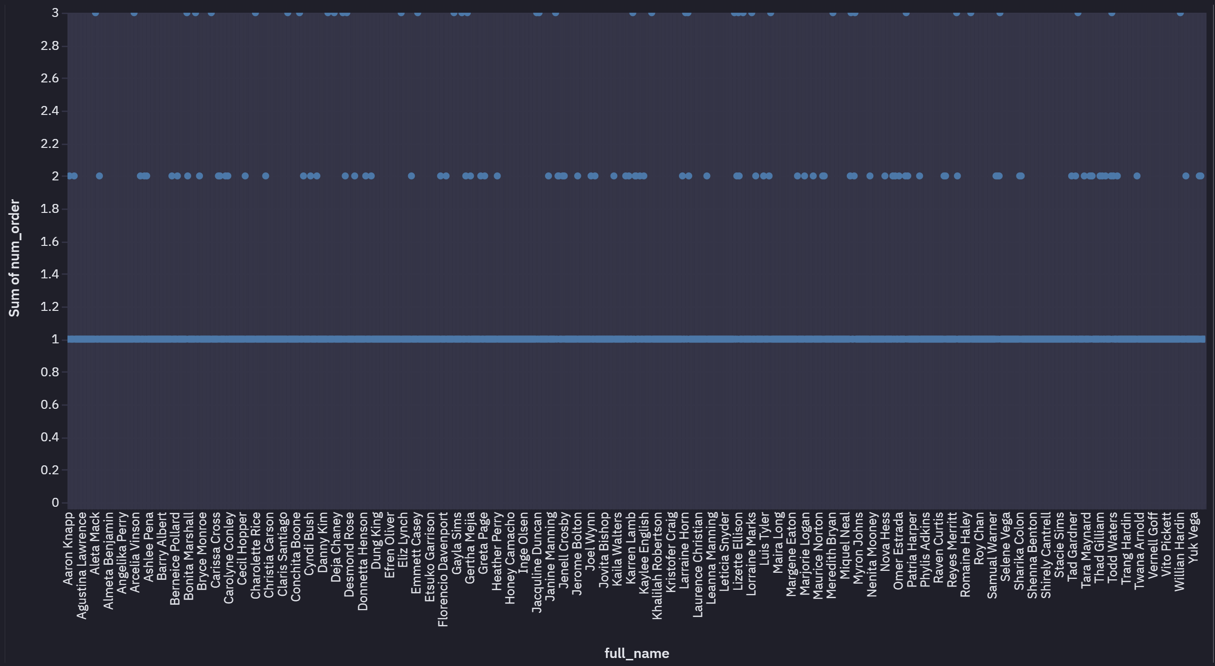
Customer Orders Count
Context :
Customer Orders across 3 years [2016 to 2019]
Observation :
Majority of customers order 1 bike/bicycle which is expected. Those who order 2 or 3 gradually decrease in frequency of orders.

Slide 9
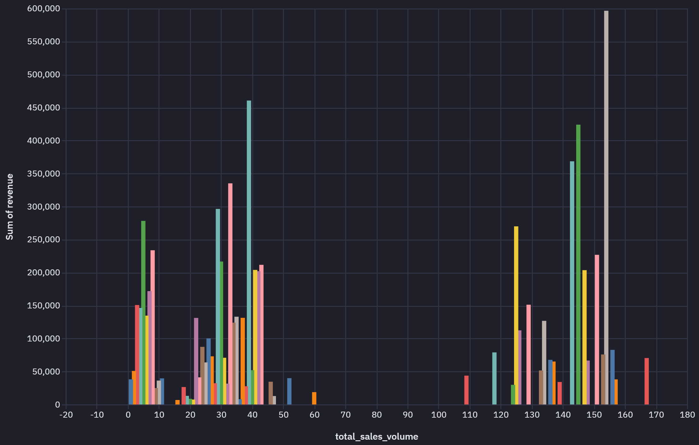
Sales vs Revenue Analysis
Context :
Sales in terms of quantity not necessarily generate higher revenue
Observation :
Sales in terms of quantity not necessarily generate higher revenue

Slide 10
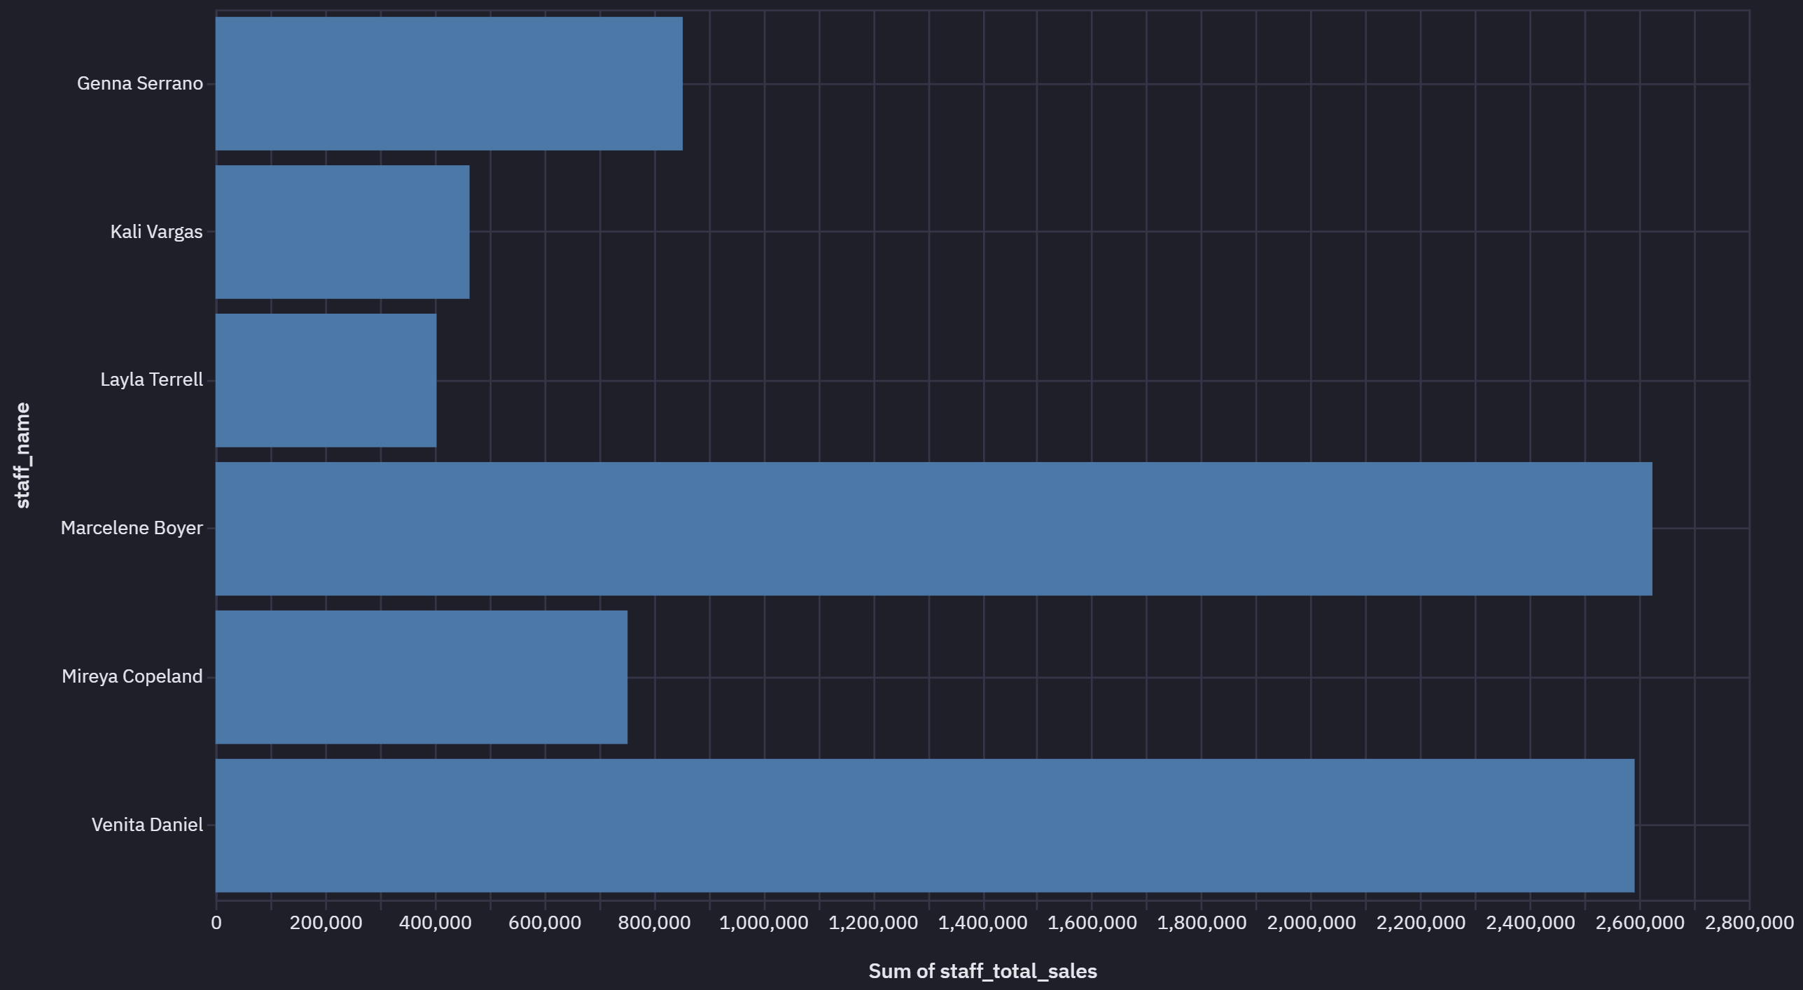
Sales Performance by Staff
Context :
Calculated total sales by staff member
Recommendation :
-- Staff can be incentivized or evaluated for performance based on the total sales numbers

Slide 11
Inventory and Stock Management
Inventory:
- Observations - To provide actionable insights derived from the bike store dataset.
- Recommendations
- To assist in making informed business decisions based on data analysis.
Stock Management:
- Observations - Data Import and Schema Overview, Data Analysis Using SQL (Descriptive Statistics, Data Cleaning, Aggregation and Grouping, Joins and Relationships, Use of Sub-queries, CTEs and Advanced Functions,), Insights and Conclusion.
- Recommendations - Brands, Categories, Customers, Order Items, Orders, Staff, Stocks and Stores details.

Slide 12
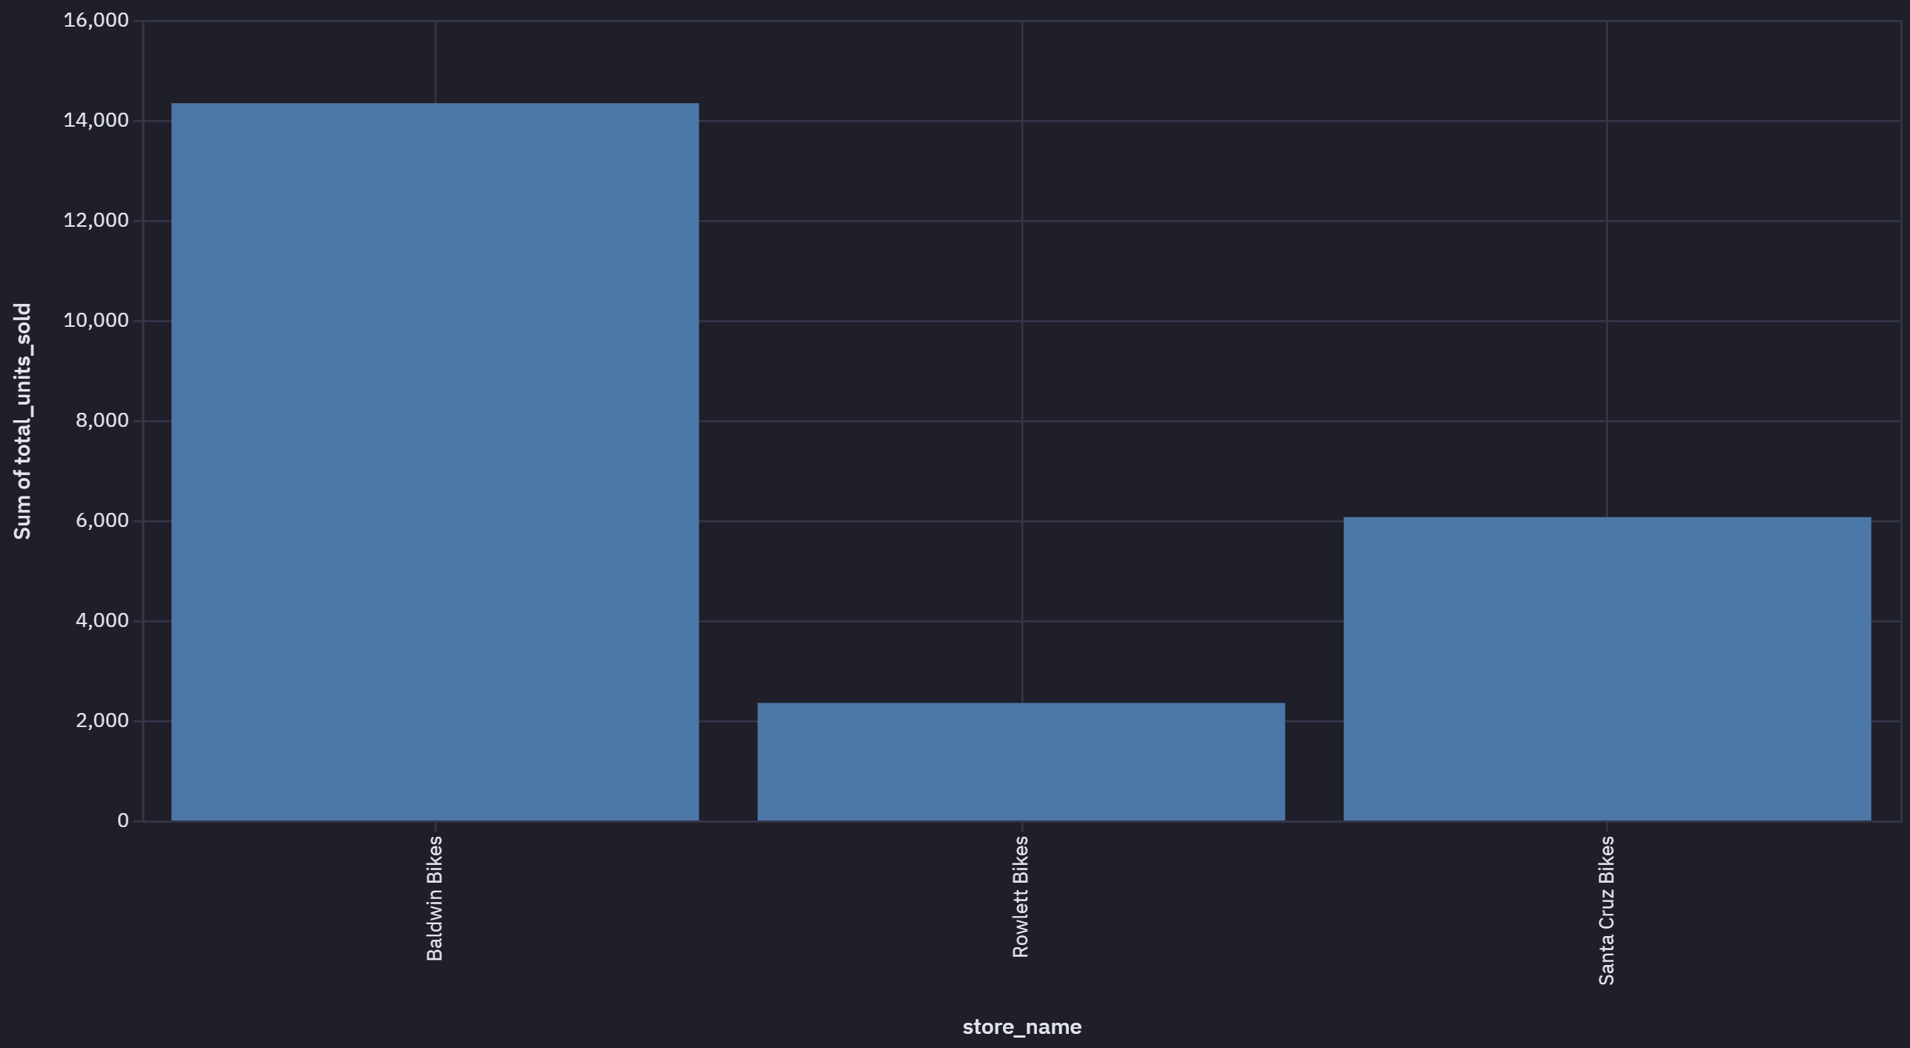
Store Performance Comparison
Context :
All the 3 stores have same number (3 excluding the over all head) of staff managing the sales.
Recommendation :
Baldwin Bikes has relatively higher sales so recommend resource rationalization by relooking under utilized staff in other stores.

Slide 13
Store Performance Comparison
Revenue:
- Observations - To provide actionable insights derived from the bike store dataset.
- Recommendations
- To assist in making informed business decisions based on data analysis.
Staff Management:
- Observations - Data
- Recommendations - Brands, Categories, Customers, Order Items, Orders, Staff, Stocks and Stores details.
Order Fulfilment and Delivery:
- Observations - Data
- Recommendations - Brands, Categories, Customers, Order Items, Orders, Staff, Stocks and Stores details.

Slide 14
Trend and Seasonality Effect
Historical Sales Trend:
- Observations - To provide actionable insights derived from the bike store dataset.
- Recommendations
- To assist in making informed business decisions based on data analysis.
Seasonality Effect:
- Observations - Data
- Recommendations - Brands, Categories, Customers, Order Items, Orders, Staff, Stocks and Stores details.

Slide 15
Summary on Insights and Recommendations
Inventory Strategies:
Implement automated alerts for low stock levels.
Analyze sales trends for better demand forecasting.
Customer Engagement:
Develop loyalty programs for top customers.
Personalized marketing based on purchasing behavior.
Staff Development:
Provide training for staff in high-performing stores.
Reassess staffing needs based on store performance.
Data Quality Improvement:
Encourage capturing complete customer information (e.g., phone numbers).
Address data gaps in shipping dates for accurate delivery analysis.
Insights:
- Observations - To provide actionable insights derived from the bike store dataset.
- Recommendations
- To assist in making informed business decisions based on data analysis.
Recommendations:
- Observations - Data
- Recommendations - Brands, Categories, Customers, Order Items, Orders, Staff, Stocks and Stores details.
Further Analysis:
Deep dive into seasonal sales trends.
Customer segmentation analysis.
Product return and refund patterns.
Business Actions:
Enhance product line based on customer preferences.
Optimize supply chain for faster deliveries.
Data Quality Improvement:
Collect missing data (e.g., phone numbers, shipping dates).
Ensure data validation in future data collection processes.

Slide 16
Conclusion
Insights:
- Observations : Sales & Customer Data
1. Total Sales: $7.68 million across 1,615 orders, with an average customer spending ~$4,761.
2. Discount Strategy: An average discount of 10% is frequently offered to boost sales.
3. Customer Base:1,445 unique customers, suggesting a limited customer pool relative to potential market size.
4. Big Spenders: 17 high-value customers (who spend 65% or more than the top spenders), with a focus on premium products.
5. Customer Contact Information: A significant gap in phone contact details (1,267 missing out of 1,445), relying mainly on email marketing.
Insights:
- Observations : Inventory & Stocking
1. Popular Models: Trek Slash 8 27.5 (2016) is the highest revenue generator, while the Electra Townie Original 7D EQ (2016) has sold the most units (54 units).
2. Stock Replenishment:
- Items like Trek Domane SLR Frameset (2018), Electra Cruiser 1 Ladies (2018), Electra Superbolt 1 20” (2018), and Electra Townie Commute 8D Ladies' (2018) should be restocked as inventory levels drop.
- Focus on balancing inventory for high-volume items (e.g., Surly Ice Cream Truck Frameset - 2016) and high-profit items (e.g., Trek Conduit+ - 2016).
3. Brands Performance: Trek and Electra brands dominate product offerings, while Ritchey and Strider brands have fewer products, possibly needing increased variety.

Slide 17
Conclusion
Insights:
- Observations : Staffing Insights:
1. Understaffing: Baldwin Bikes, despite high sales, only has staff, indicating potential understaffing.
2. Staff Performance: Staff can be incentivized based on total sales numbers.
3. Manager Allocation: The ratio of managers to staff is low, and certain stores may not require as many managers (e.g., Fabiola manages herself without oversight).
Insights:
- Observations : Inventory & Stocking
1. Popular Models: Trek Slash 8 27.5 (2016) is the highest revenue generator, while the Electra Townie Original 7D EQ (2016) has sold the most units (54 units).
2. Stock Replenishment:
- Items like Trek Domane SLR Frameset (2018), Electra Cruiser 1 Ladies (2018), Electra Superbolt 1 20” (2018), and Electra Townie Commute 8D Ladies' (2018) should be restocked as inventory levels drop.
- Focus on balancing inventory for high-volume items (e.g., Surly Ice Cream Truck Frameset - 2016) and high-profit items (e.g., Trek Conduit+ - 2016).
3. Brands Performance: Trek and Electra brands dominate product offerings, while Ritchey and Strider brands have fewer products, possibly needing increased variety.

Slide 18
Q&A

Slide 19
Appendix

Slide 20
Technical Details on Project Setup
Environment Setup:
Connected to Azure Database for remote access
Azure Database Connection details:
Host: group3.mysql.database.azure.com
Port: 3306
User: group3
Project Directory:
Created a dedicated directory for the project files in GitHUB. Included SQL scripts and data files.
Data Import:
Loaded the provided schema and data into the MySQL database.
Ensured all tables and relationships were correctly established.

Slide 21
Data Cleaning
Identified Issues:
Missing phone numbers in customers and staffs tables.
NULL values in shipped_date in orders table.
Actions taken:
Decided to retain entries with missing phone numbers to preserve data integrity.
Noted the missing shipped_date values for consideration in shipping time analysis.
Rationale:
Retaining records ensures a comprehensive analysis.
Missing values can inform about data collection processes and areas for improvement.

Slide 22
Use of Aggregates and Joins
Identified Issues:
Missing phone numbers in customers and staffs tables.
NULL values in shipped_date in orders table.
Actions taken:
Decided to retain entries with missing phone numbers to preserve data integrity.
Noted the missing shipped_date values for consideration in shipping time analysis.
Rationale:
Retaining records ensures a comprehensive analysis.
Missing values can inform about data collection processes and areas for improvement.

Slide 23
Use of several Sub-Queries and CTEs
Identifying Low Stock Products:

Slide 24
Use of Advance SQL Functions
Calculating Running Total of Sale
Year-over-Year Sales Growth:

Slide 25
Interesting queries
-- Identify top 5 products by total sales
SELECT
p.product_name,
SUM(oi.quantity * oi.list_price * (1 - oi.discount)) AS total_sales
FROM
order_items oi
JOIN products p ON oi.product_id = p.product_id
GROUP BY
p.product_name
ORDER BY
total_sales DESC
LIMIT 5;
Findings:
The top-selling product is Trek Slash 8 27.5 - 2016, generating the highest revenue.
Indicates high customer preference, suggesting a focus on inventory and promotion for this product.

